Slide 1


Celebal Project Domain – Power BI Team – PB-1
Made By – Piyush Bhargav
Paramjeet Solanki

Slide 2
Objective
Create a Report using Financial Year Dataset making measures by Dax formulas in Power BI.
Applying DAX in following points are:-
Total Quantity Sold
Quantity Sold Last Month
Quantity Sold Last Year
Average Quantity Sold per Day
Quantity Sold in “Germany” and “Dell” & “Hp”
Quantity Sold Two Month Ago
Quantity Sold Two Quarters Ago
Last Month Profit
Profit 2 Month Ago
Last Month Cumulative Profit
Cumulative Profit 2 Month Ago
Total Profit Running Total in Date
How To Apply Fiscal Year
Apply Currency Conversion.

Slide 3
What’s New
We have applied the fiscal year in the given data set in which we can divide the year in a two different parts. Like example (FY 14, FY15).
There is also a cumulative profit to find the cumulative profit last month and last two month in which we have used the conditional format so that we can get actual cumulative profit.
There is an Data Visualization part where we can drag and drop of the values we can make graphical representation.
Slicer is the main part in which we can drag and drop the values in there data field and after that with the help of slicer we can select the particular value to get visuals of that particular values which we selected in the slicer.
Filter options are also a interesting part in the Power BI in which we can drop the values in which when we select that dropped values in tha filter options so that we can that values or we can top values in that field.

Slide 4
Target Audience
Company executives - Company executives utilize these reports to determine how the business is running. By monitoring spending and comparing administrative and production costs, company executives can make decisions about how to manage the business, control production and administrative costs, and reduce any inefficiencies within the organization that increase spending.
Financial advisors - Financial advisors, particularly those with experience with start-ups and small businesses, can obtain a wealth of information from financial statements. A financial advisor can help business owners decide how to improve performance and maximize profits by analyzing the data.
Accountants - Whether a salaried employee or an outside accounting firm, accountants will help prepare and review the financial documents, verify their accuracy, and also use the information provided to create tax documents and file yearly or quarterly taxes.
Current and potential vendors - Financial statements are a valuable tool for an organization when establishing a credit line and credit terms with potential vendors or improving current terms with partnered vendors. Vendors use financial documents to estimate the potential risk of extending credit to an organization and determine the company's ability to pay the debt on time.

Slide 5
Technology Used
Power BI
Power BI is a business analytics service by Microsoft. It aims to provide interactive visualizations and business intelligence capabilities with an interface simple enough for end users to create their own reports and dashboards. It is part of the Microsoft Power Platform.
DAX (Data Analysis Expression)
DAX is a collection of functions, operators, and constants that can be used in a formula, or expression, to calculate and return one or more values. Stated more simply, DAX helps you create new information from data already in your model.

Slide 6
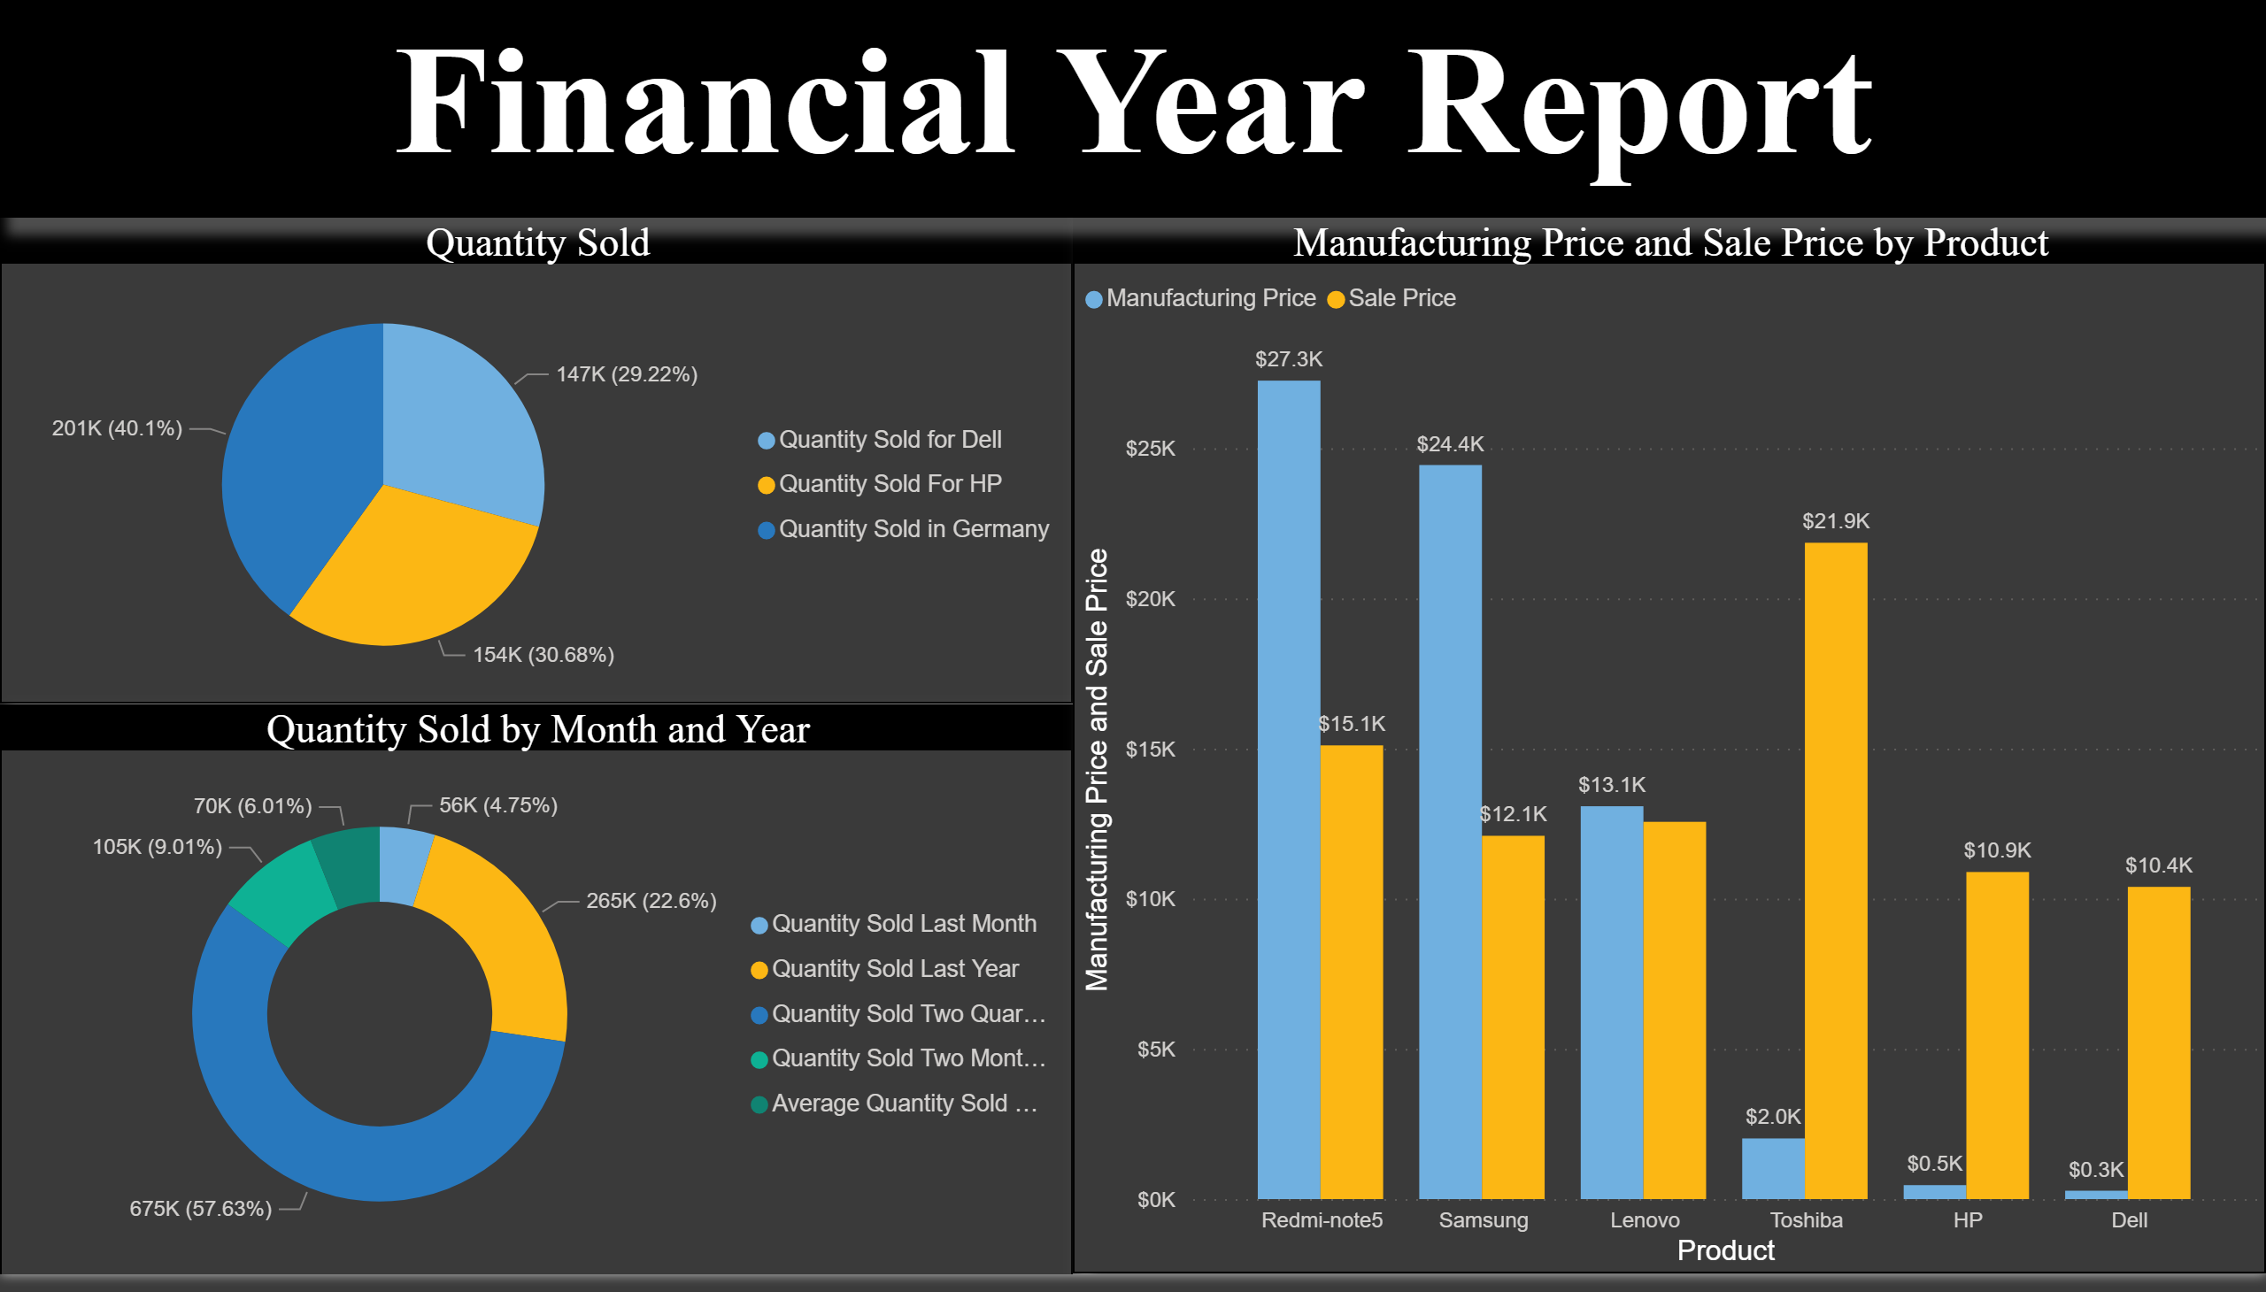
Project Demonstration

Slide 7
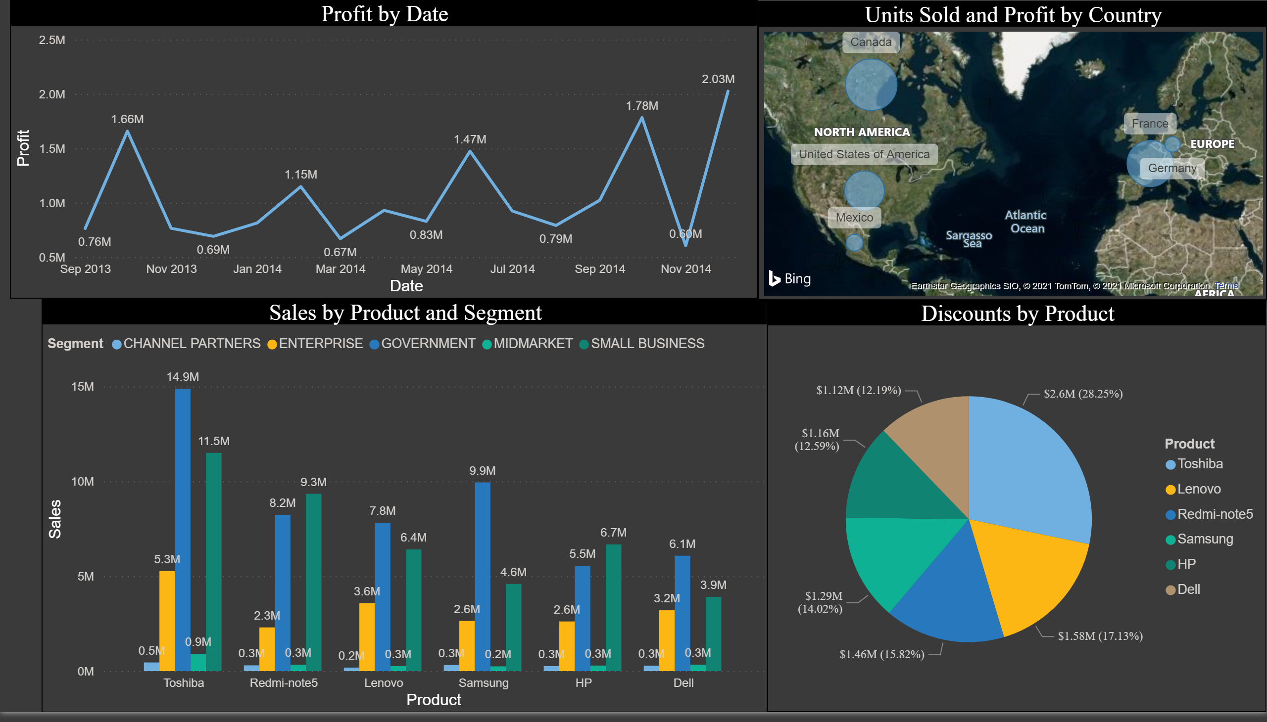
Page 2
Notes:
lineChart
No alt text provided.
map
No alt text provided.
clusteredColumnChart
No alt text provided.
pieChart
No alt text provided.

Slide 8
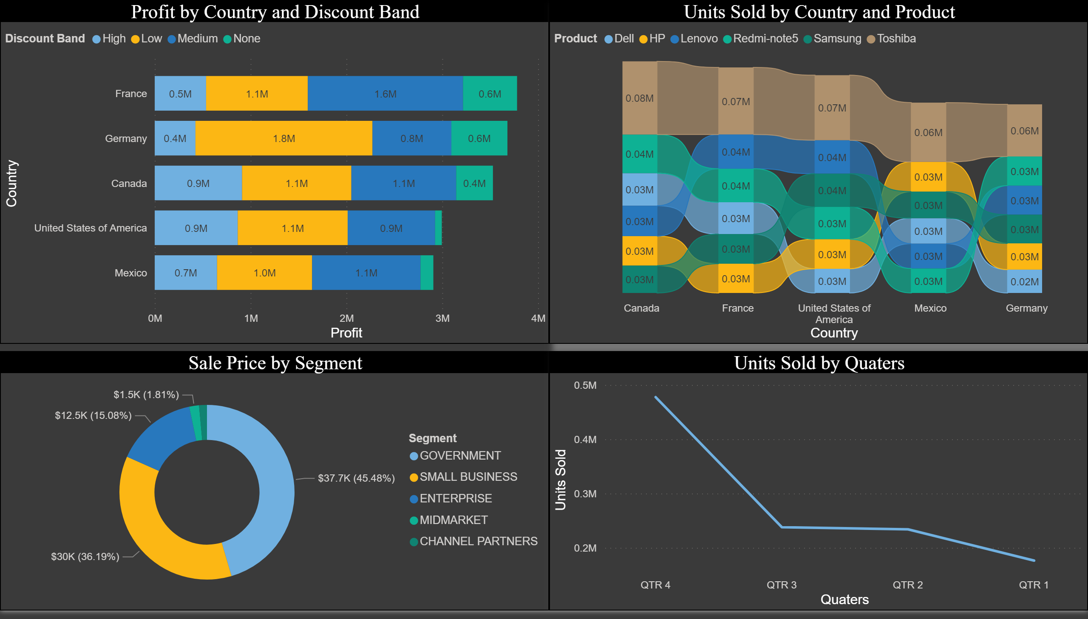
Page 3
Notes:
barChart
No alt text provided.
donutChart
No alt text provided.
ribbonChart
No alt text provided.
lineChart
No alt text provided.

Slide 9
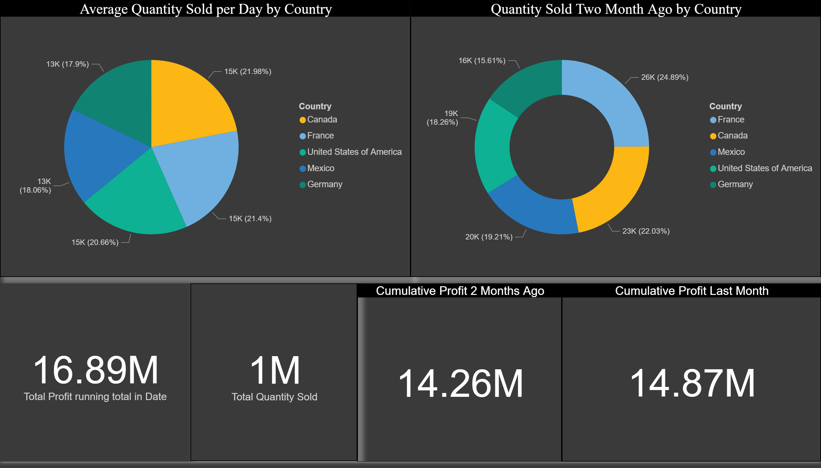

Slide 10
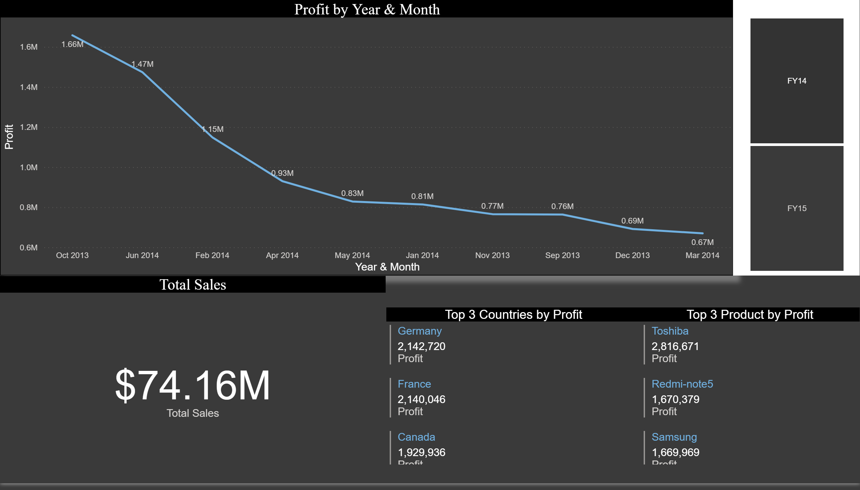
Page 5
Notes:
lineChart
No alt text provided.
Total Sales
No alt text provided.
slicer
No alt text provided.
Top 3 Countries by Profit
No alt text provided.
Top 3 Product by Profit
No alt text provided.

Slide 11
Future Score
The future scope of this is very vast we can use this dashboard in any sales inventory or in any business Financial Analysis
For future Scope we also use power bi feature by extracting data form web or dumping SQL
As we have taken the Fiscal Year of 2013 and 2014 for that we can connect are Model with the Web server or any Sql Server and apply refreshing query and Keep adding the data in model for yearly Calculation
Most important scope is that we can understand all type of Insights of Product , Price of Product.
The demand for BI (Business Intelligence) and Decision Making will not dip in the near future. Definitely, no other BI tool is going to overcome Power BI’s dominance in the next ten years. Also, Power BI is easy to use and excellent for data visualization.
Moreover, the product is a Microsoft product. What makes it potent is that a range of products from Microsoft are already global leaders. Integration with Power BI is not only essential but also it augurs well for its users as the brand ensures it is here to stay with adding features every week at a random pace.

Slide 12
Conclusion
We have conclude the financial year of a business by calculating different measure and different graph.
Conclusion through this project are different way in context of learning we have a lot new thing through making measure and trying out new graph which suites the visualization of data .In context for real world ,Form working like a team and solving the problem that where given by the mentor to Making the visualization look more great as firstly learn how to work in small team.
This project simple conclude that through the same model we can apply to any business financial year and GST a major insights that how there business is working and what insights form a power bi can give the can increase there sales or increase there business.

Slide 13


Thank You

